Slide 1
Evidence Journal Project 3: Breaking Horizons
Summative
AAD531 Front-end Web Design
Name: Prapti Ankush Mane
Student ID: 13491449
Date: 18/06/2021

Slide 2
Complete the following pages
Make the Evidence Journal your own, add and change fonts, add extra pages!
Note: Delete all instructional pages and text from this template before you submit!

Slide 3
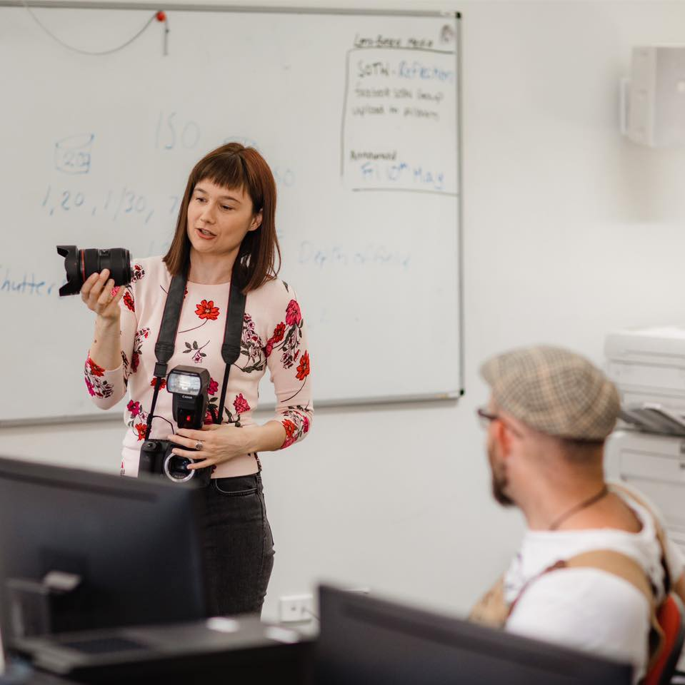
Referencing
It is important you reference any material which is not your own. This includes images, quotes and information. Refer to the Resources section for referencing guide, exemplars and further information.
Tip: When you reference an image use 8pt font like this
Reference any images that are not your own in numerical order throughout your Evidence Journal. Then at the end include an appendix with the slide name and refence information. See the end of this template for an example.
Fig. 1

Slide 4
Annotations
Include annotations as you go along. What are annotations? They are brief notes documenting your thoughts and process. They can include camera data and information on how you created your image. Think of your Evidence Journal a bit like a diary or notebook, it gives you a chance to express yourself and your journey.

Slide 5
How to annotate your work
Include information, such as
the title of the image, artist's name and details or when it was created
a record of your experiences and emotions connected to an image
a record of how you intend to use these images to develop your own ideas
an example of your progress through a project
To annotate your work successfully, you should explain:
what you have done? and why you did it?
how you did it? such as the media and techniques used
why you chose a particular medium or technique
how the artwork fits in with your project?
what aspects you like and why?
how you could improve the work?
what you think you will do next?

Slide 6
How to annotate your work
Use the correct vocabulary when annotating your work to show that you are developing your knowledge, understanding and skills.
Visual language terms
Subject - what is shown in the artwork, such as a portrait or a still life
Composition - how the elements of the work are arranged, i.e. whether they're close together or far apart
Foreground and Background - elements that appear to be in front of or behind other aspects of the artwork
Line - can vary in width, length, curvature, colour or direction
Shape - describes the two-dimensional outline
Form - describes a three-dimensional object
Texture - the way surfaces look and feel, i.e. grain, sharp, blur, etc.
Tone - shading, from dark to light

Slide 7
What is an Evaluation
An evaluation is a piece of writing where you look at your project as a whole and discuss its successes and weaknesses. This can help others understand what you were trying to achieve. You need to be honest and use the appropriate art language.
When you're evaluating your preparatory work, you should consider:
What was the theme for the project?
How have you developed your ideas?
How did your work change through the project?
How much reference material did you find?
What artists, art movements or cultures have you looked at to help and inspire you?
What materials, tools and techniques did these artists use?
How have your skills developed during the project?
Are there any aspects of your studies that you wish you had explored further?
You also need to evaluate your final piece:
You should reference relevant work from your preparatory studies
How have you used formal elements such as line, tone, colour and shape?
What materials did you use, and why? Did they work successfully?
What meaning and messages did you want to convey and were you successful?
Are you happy with your final piece? Are there any elements you like in particular?
Is there anything you would change? Why?

Slide 8

What is an Evaluation
All evaluations are structured and performed in the same way, so you may also find this helpful for future reference.
Note: To play this video click on SlideShow>From Current Slide

Slide 9
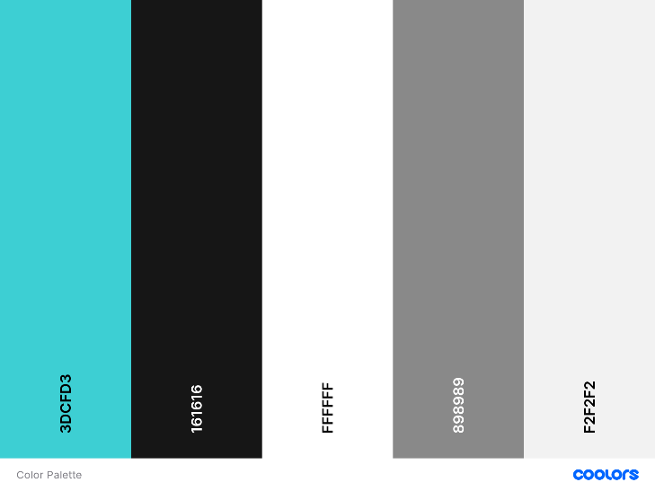
Colour choices
The reason for these colors were approved by the client. She has always used this color even for her visiting cards hence the colors were established by the client. The reason she told me behind these colors is that it is gender neutral. Since my client caters to men, women and children these colors seem ideal choice. The buttons have the border of the turquoise where they’re on a black background as it really helps the button stand out and when you hover over them the background of the button turn completely turquoise. The text on the buttons is in white which is standard throughout the website as somewhere the buttons are on a black background, and you won’t be able to read black text. I have used span on my headers so the text could be colored accordingly. The social media icons have a turquoise hover. Services grid boxes also have a turquoise hover. Since the send message button is on a white background the button is turquoise and the text inside the button is in black, and the hover for that button is white.
I used https://coolors.co/ to generate the color palette.

Slide 10
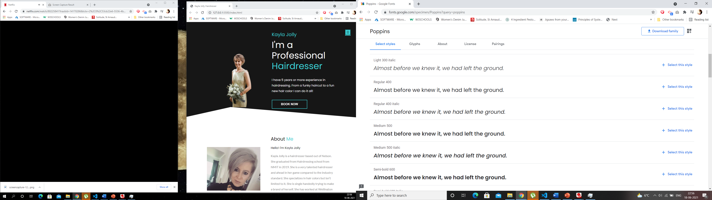
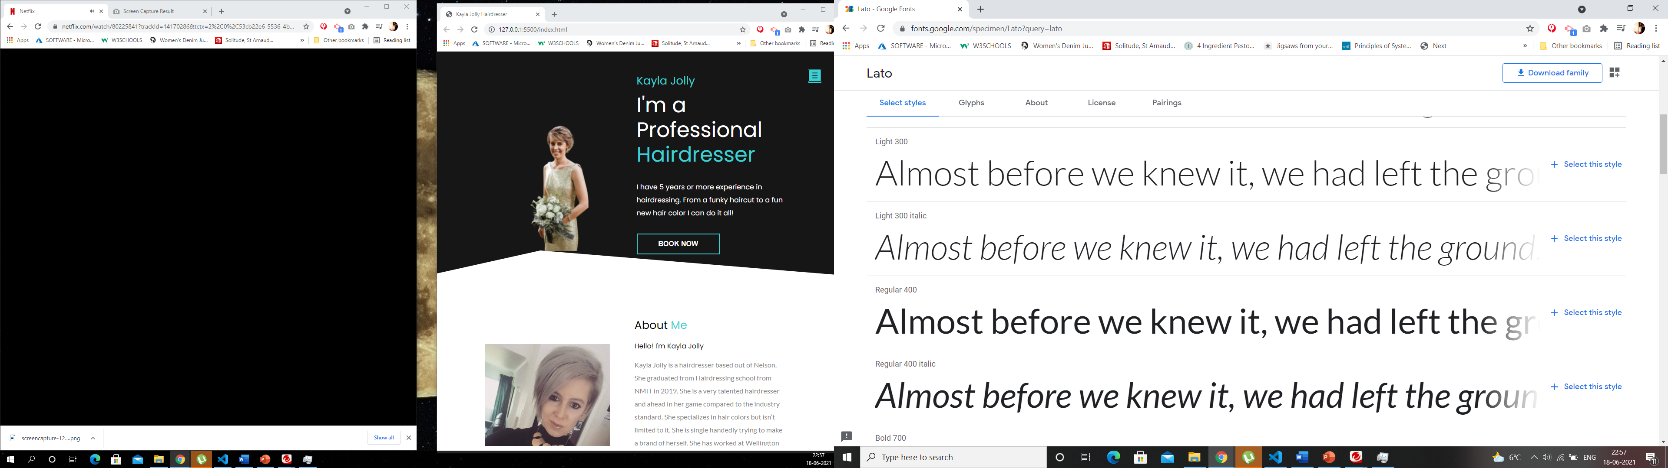
Font choices
I have used Google font to download my choices of fonts. I have used two times of fonts, Poppins and Lato. The body of the website is written in Poppins, and the fall over font is sans-serif incase Poppins doesn’t work. The about me section, the paragraph section for services, the text on the cards, the book an appointment paragraph all uses the Lato fonts. The reason I chose these fonts is because I thought they go well with the colors of the website, and it feels gender neutral just like the brand.

Slide 11









SVG choices
Kayla Jolly only has Facebook and Instagram for her brand at this stage, but she will be making a Linkedin profile soon, hence I have also added a linked plugin. The plugins are under the about me section after the paragraph finishes.
I have used https://www.flaticon.com/ to download the icons.

Slide 12
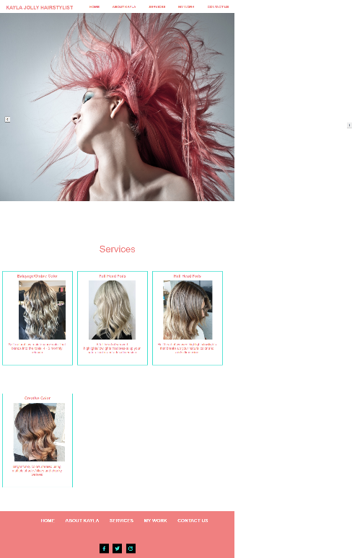
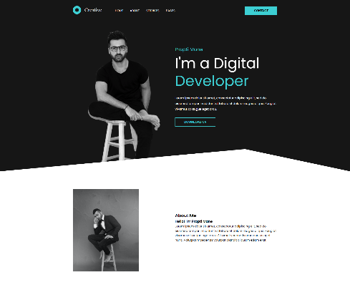
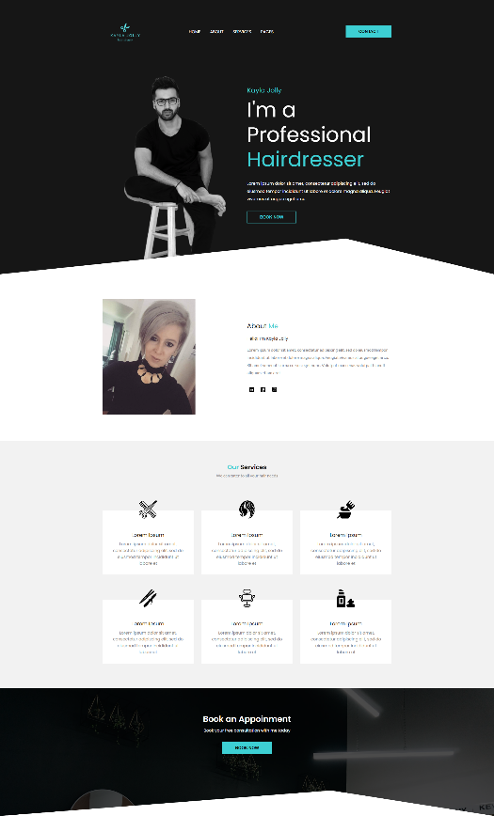
Evolving design
The design of the website is a mixture of what we had 2 years ago, I mixed it up with the new portfolio design that I found online.
This is the link of the tutorial that helped me build this website.
https://www.youtube.com/watch?v=8r1MHZec4Hc
I have changed the design slightly, but not too much cause it was perfect with what my client is looking for, hence I have changed a few things.
On the left you can see the screenshots of the evolving stage of the design. The logo for the website was created using Canva. Couple of years ago Kayla Jolly didn’t want a logo but this time she decided she want a logo for the website hence I used Canva to create the logo.
As you can see 2 years ago we were using Turquoise and Pink but we have realized the previous design was extra pink which promoted that it’s a feminine brand but now Kayla has also started barbering side of things which is gender neutral hence the pink is not needed anymore.
In the final design we have changed the Banner image this image will be changed again once Kayla gets a photoshoot done, as well as the about me image
As far as the CSS is concerned I have created

Slide 13
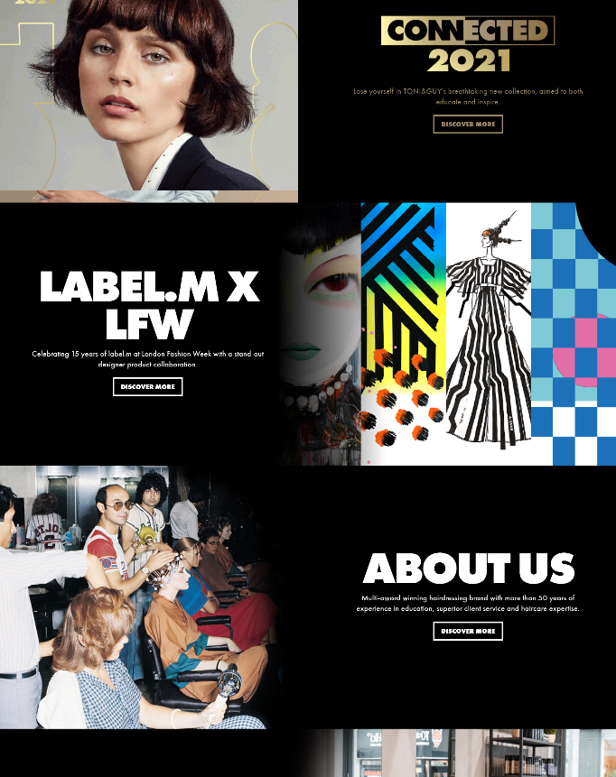
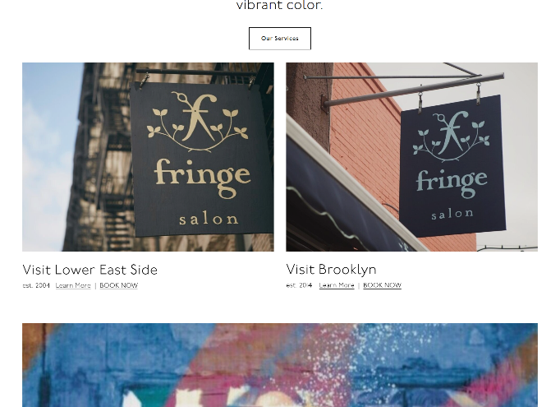
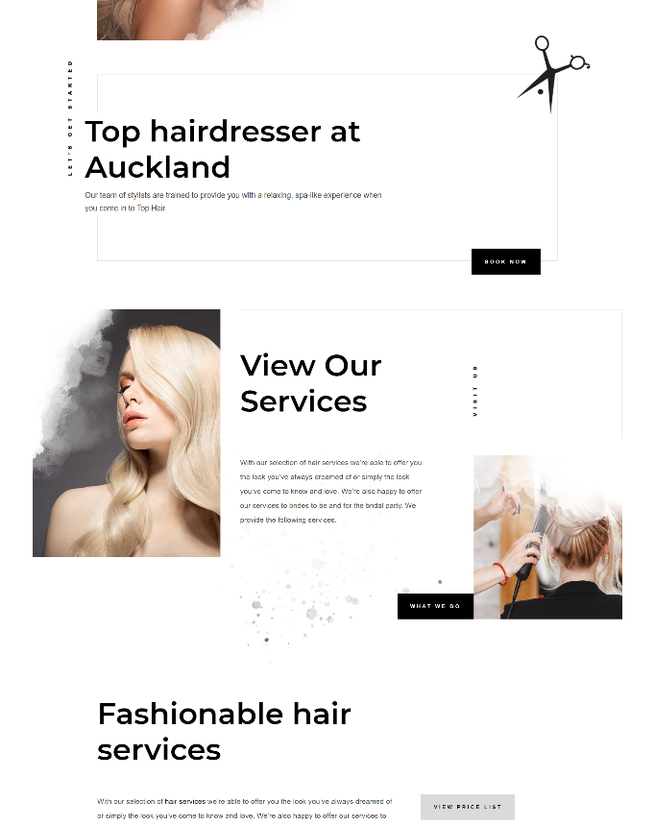
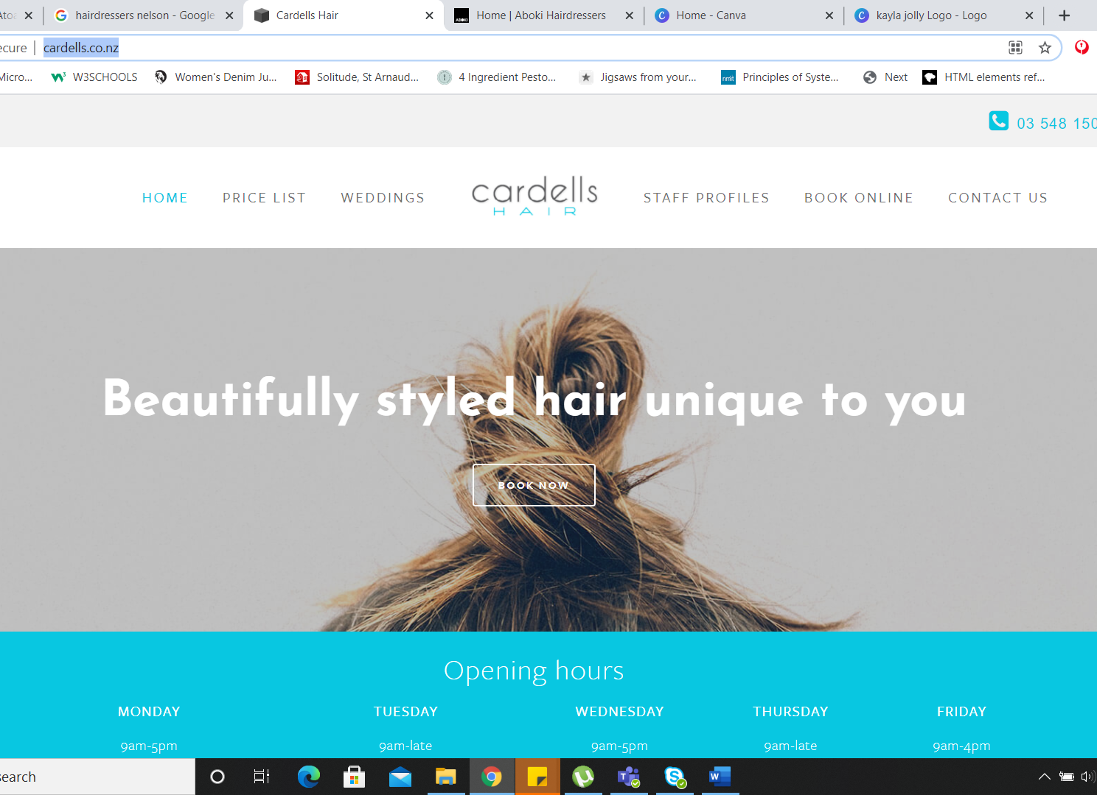
Inspiration
This is the link to the video tutorial that I used to create my website, since the layout was very similar to what I was looking for my one-page website, it worked out well. Especially since this guy does not give source code and more importantly, he explains everything step by step which is quite useful/helpful. The tutorial is not in English.
These are some of the design inspirations that helped me with the design and the colors used in the website as well showed me how important using the correct font is for the website. These websites are very high end and would also require that kind of budget but if you compare my design to these websites, it looks pretty professional build too. These are not a single page application websites.

Slide 14
UXD Analysis
The best part about this website is that it is a One page Application, which means the user does not need to browse across different pages to hunt for information, it is all accessible on the landing page. The colors of the website are popping enough to attract the users attention but not so much that it would be annoying to look at after a certain point. The buttons of the website are big enough so the user would not struggle with it on a smaller device or any other device. The website works well in all devices as it is fully responsive. The design is modern yet basic, there is no guess work involved when it comes to using this website. There are some interactive elements on the website which give the website a nice touch, the hover and svg icons which are used for services make the website look professionally made. The client was very happy with this layout of the website, including the color palette that I suggested. The images used for my work section is the clients real work, which according to me makes the website look attractive and the message about the brand is conveyed with more power. The images which are used are just taken off of Kayla Jolly’s facebook for now since she hasn’t done a professional shoot. I have informed her about the resolution and the orientation of the images required. The original design is by this Indian web developer who tutorial has been cited in this report.

Slide 15
UXD Analysis
One of the best things about this website is the slider for the reviews, this is a nice modern feature which helps the users read the reviews of the brand without overpowering them with too much information and this helps avoid negative comments, incase we keep it open for the users to comment. Hence it is better if we list these comments on our own. I have changed a few things from the original design, as per what I thought would work better for the brand. Span on the heading of the website, which I have in different colors makes the website look more attractive and it immediately takes your eyes to the headings. Everything on the website is very well aligned. Although the footer of the website is not something the users are going to like when they come to this website, but that can be changed before we make the website live. The important things that the users are going to look at when they come to this website is the services that the brand provides and their previous work to make an informed decision, both these things are well placed on the website and the user should’ve no problem navigating to these using the nav bar. One of the other drawbacks of the website is that I have put the links on the buttons on their text instead of on the entire button hence if the user clicks on the empty space, nothing will happen hence they need to click on the text inside the button for the navigation to work correctly.

Slide 16
Professional practices and standards
This is one of the most important things especially when you’re working with clients directly and do not have a project manager as your point of contact. A client does not speak designer/developer lingo, they speak plain English and it is our responsibility to help them understand exactly what we need from them and what their requirements are before taking on the project. Projects can easily go over budget if the requirements are not established and stated clearly during the estimate stage. As a designer our responsibility is to figure out exactly how long a design/development time will be and only then commit to work. Always give the clients a clear picture, cause the clients can have some different expectations as compared to yours and then you do not want to not be able to fulfil it, hence communication needs to be clear and straightforward. Be honest clients appreciate honesty. Make sure all your content etc has it’s copyright in place. When you make a website make sure to put your copyright at the bottom of it.
Customer Service

Slide 17
Your final design
Here you will need to write a short ‘final evaluation’ on your progress throughout this project. Try to be reflective as much as possible, talk about the successes’ and troubles you may have overcome, explain the reasons behind your final design and what you would improve if you had the chance to do so.
LINK to your website HERE
You must ensure you have provided a link to your website here.

Slide 18
Your final design
Here you will share large screen shots of your final website, use as many pages as you like and make sure to share screen shots of all aspects of your website.

Slide 19
Appendix
Slide 3 - Jessica Shirley 2019, www.jessicashirley.nz

Slide 20
Bibliography
Fringe salon ny. (n.d.). Fringe Salon Ny. Retrieved June 19, 2021, from https://www.fringeny.com
TONI&GUY. (n.d.). Retrieved June 19, 2021, from https://toniandguy.com
Muse Salon and Spa. (n.d.). Muse Salon and Spa. Retrieved June 19, 2021, from https://www.musesalonandspa.com
Talented Hairdressers in Auckland | Newmarket Top Hairdresser. (n.d.). Top Hair. Retrieved June 19, 2021, from https://tophair.co.nz/
Coder’s Gyan. (2020, February 14). Create a Personal Portfolio website using html and css step by step in Hindi in 2020 🔥🔥 Part 1. https://www.youtube.com/watch?v=8r1MHZec4Hc

Slide 21
Submission
Remove instructional text
Check for errors in spelling or grammar
Format your writing and images, so they are clear and easy to read.
Check your referencing – include an appendix and bibliography
Check the assessment brief to ensure you have completed all of the requirements and learning outcomes.
Name your document correctly For example AAD531JessShirleySummative.pptx

